Slide 1
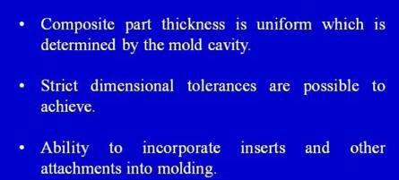
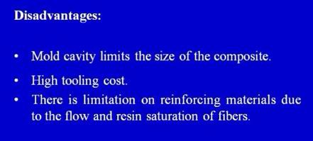
Assist.Prof.Dr. Dhia ahmed

Slide 2
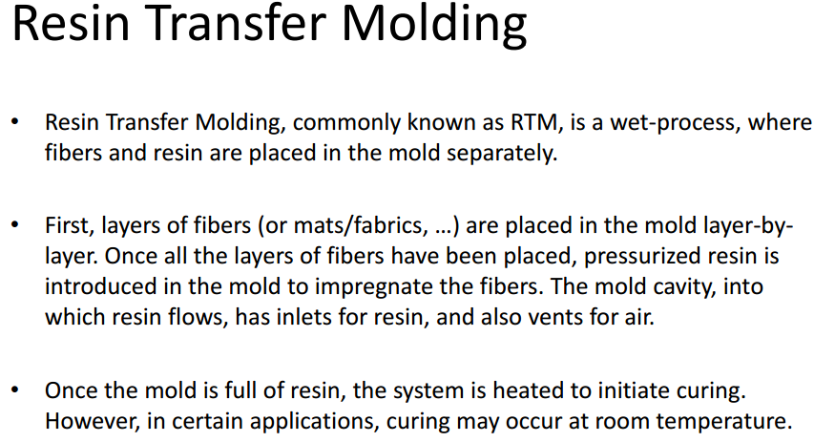

Assist.Prof.Dr. Dhia ahmed

Slide 3
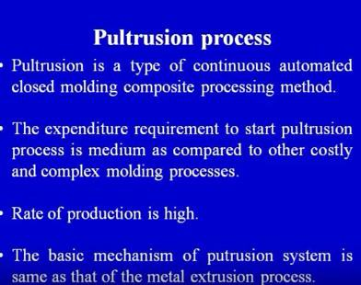
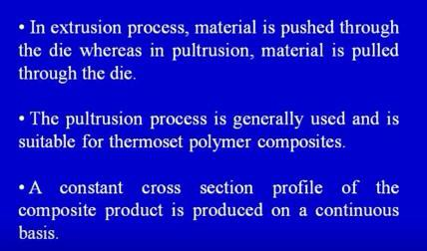
Assist.Prof.Dr. Dhia ahmed

Slide 4
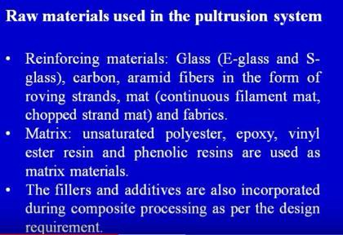


Assist.Prof.Dr. Dhia ahmed

Slide 5


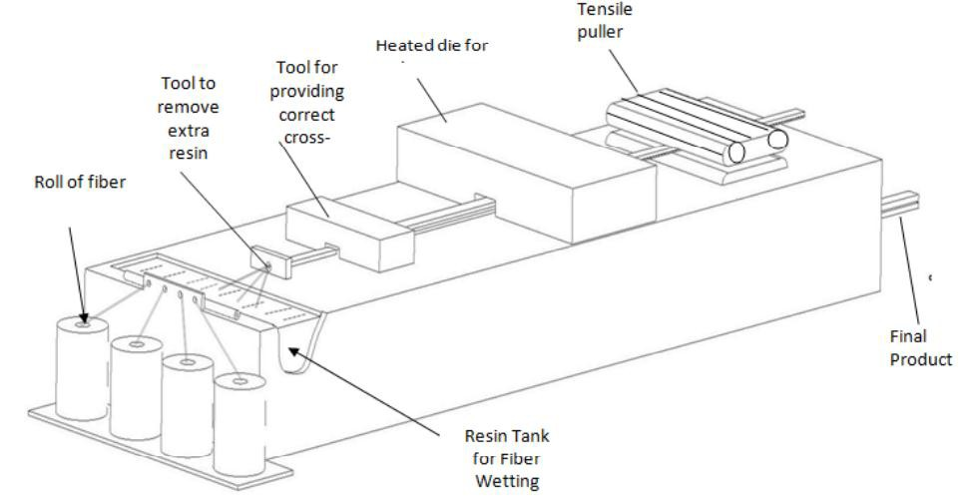
Assist.Prof.Dr. Dhia ahmed
4Figure : basic schematic for pultrusion process

Slide 6

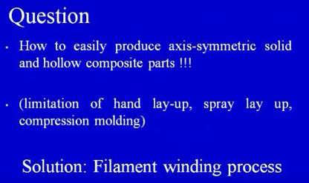
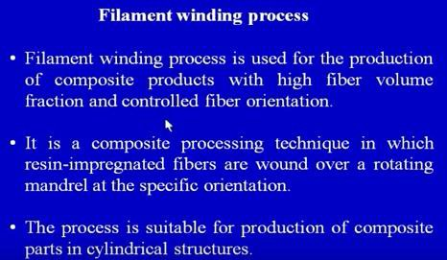
Assist.Prof.Dr. Dhia ahmed

Slide 7
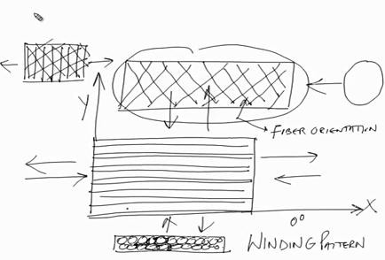
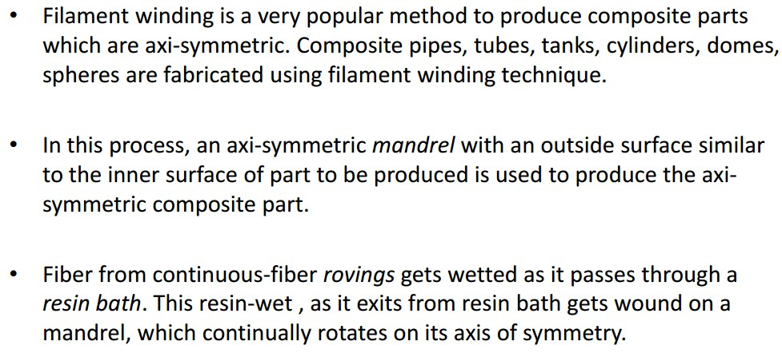
Assist.Prof.Dr. Dhia ahmed

Slide 8
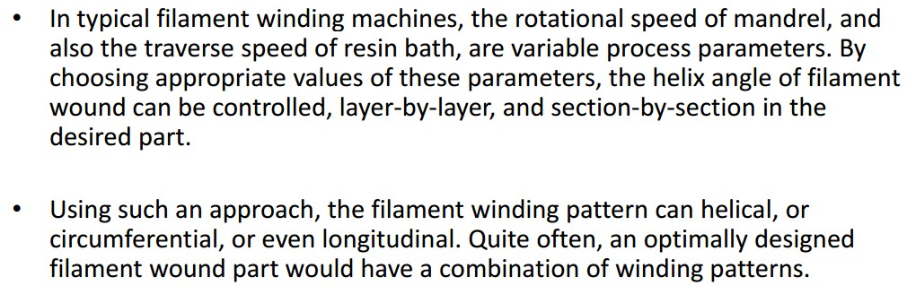

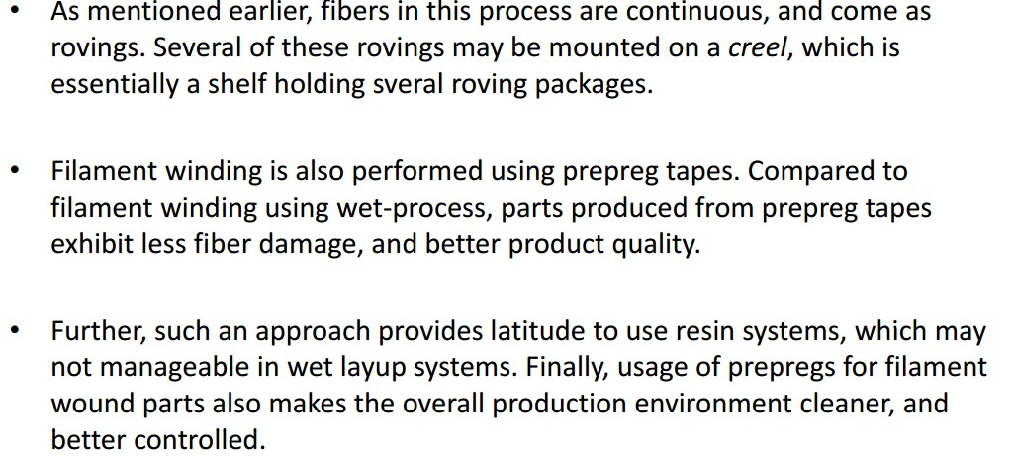

Assist.Prof.Dr. Dhia ahmed

Slide 9

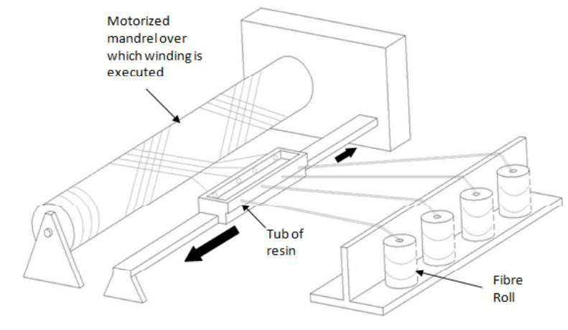
Assist.Prof.Dr. Dhia ahmed
Figure: filament winding schematic

Slide 10
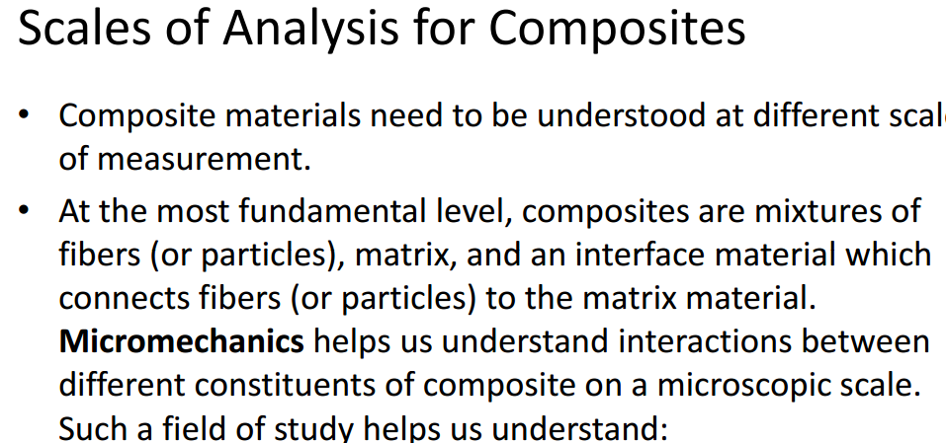

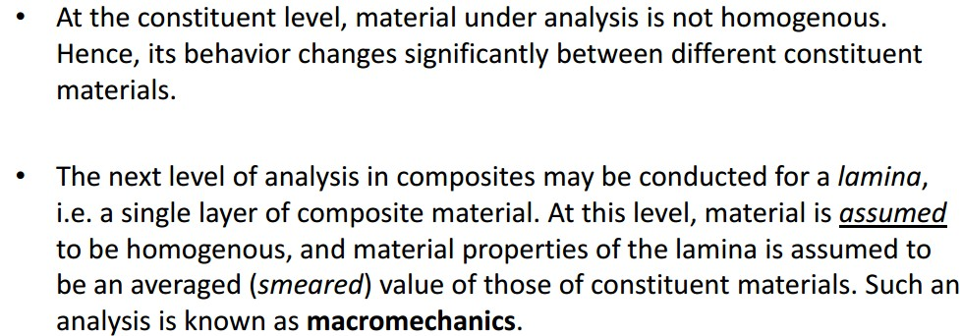
Assist.Prof.Dr. Dhia ahmed

Slide 11




Assist.Prof.Dr. Dhia ahmed

Slide 12

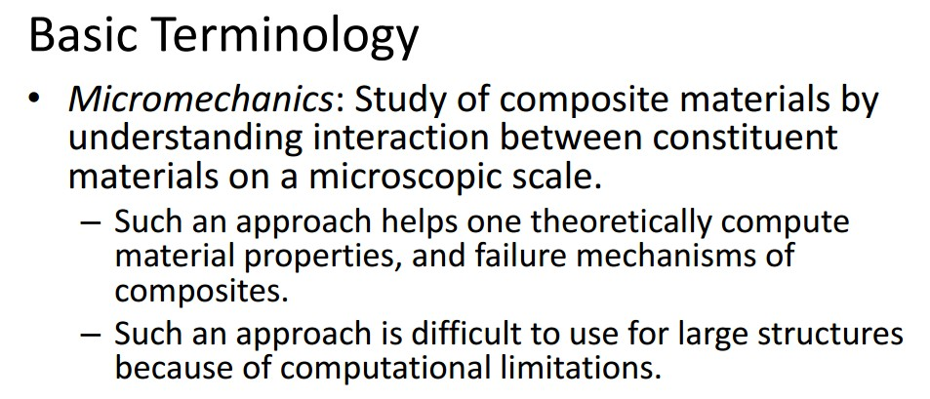

Assist.Prof.Dr. Dhia ahmed
Fig. different analysis of composite materials

Slide 13
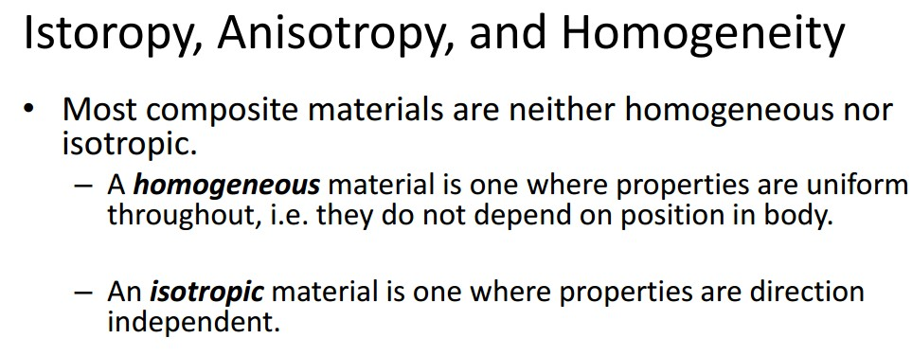
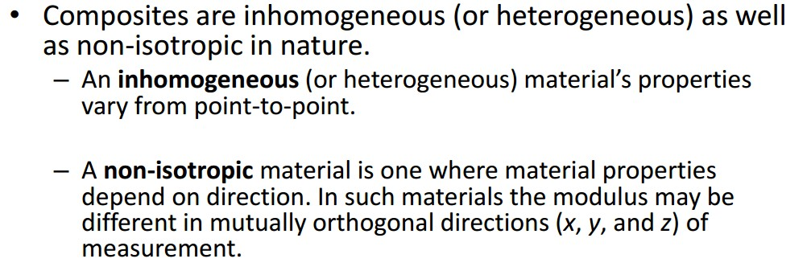


Assist.Prof.Dr. Dhia ahmed

Slide 14

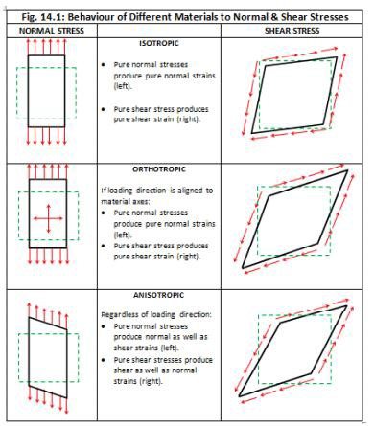
Assist.Prof.Dr. Dhia ahmed

